Slide 1
Deep Learning Based Approach for Tamil Palm leaf Manuscript Recognition

Slide 2
Abstract
Palm leaf manuscripts carry great historical and cultural value, but their preservation and readability are hindered by noise and intricate backgrounds.
A systematic deep learning-based workflow is proposed to enhance and recognize palm leaf manuscript images, starting with preprocessing steps like grayscale conversion, noise reduction, and binarization.
Furthermore, super-resolution is applied to enhance the clarity of binarized images, ensuring improved readability and better archival quality.
After enhancement, bounding box detection localizes character regions, followed by character extraction and classification using a CNN-based model for accurate text recognition.
The proposed system’s performance is evaluated using PSNR for image quality and accuracy metrics for character recognition. The results demonstrate significant improvements in the quality and readability of palm leaf manuscript images.

Slide 3
Base Paper Details
Maheswari, S. U., Maheswari, P. U., & Aakaash, G. S. (2024). An intelligent character segmentation system coupled with deep learning based recognition for the digitization of ancient Tamil palm leaf manuscripts. Heritage Science, 12(1), 342.
Indexed in: Science Citation Index Expanded (SCIE)
Year of Journal base paper publication: 2024
DOI: https://doi.org/10.1186/s40494-024-01438-4

Slide 4
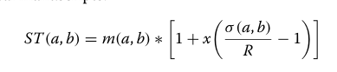
Existing systems
A systematic deep learning-based workflow is proposed for segmenting and recognizing Tamil characters from palm leaf manuscript images.
The process begins with preprocessing, which involves enhancing the image quality using Fast Non-Local Means (Fast-NLM) denoising to eliminate noise while preserving important features, followed by median filtering to improve image clarity.
Binarization is performed using Sauvola thresholding, which enables effective separation of character foreground from the background, especially in cases of uneven illumination and textured surfaces.
Various thresholding techniques such as Otsu, Triangle, Niblack, and Sauvola were applied to the manuscript data. Among these, Sauvola thresholding provided better foreground and background separation with minimal noise compared to the others.
The Sauvola threshold for each pixel is computed using the formula:

Slide 5
Further preprocessing steps include applying algorithms for punch hole removal and automated cropping, which help adjust the manuscript edge contents and eliminate scanning artifacts.
The system then performs segmentation through a three-phase process: It first trisects the manuscript to reduce text curvature, then applies an Augmented Horizontal Projection Profile (HPP) for line segmentation, and finally uses bounding boxes with Non-Maximum Suppression to accurately isolate individual Tamil characters.
The extracted characters are then classified using a multi-class Convolutional Neural Network (CNN)-based model, enabling accurate recognition of the Tamil manuscript text.

Slide 6
Proposed System
In this work, a systematic deep learning-based workflow is proposed for enhancing and recognizing palm leaf manuscript images.
The process starts with preprocessing, including grayscale conversion and Non-Local Means Denoising (NLMD) to reduce noise while preserving key details.
Binarization is done using adaptive thresholding, allowing effective separation of text from uneven or complex backgrounds while preserving fine details.
A super-resolution model FSRCNN (Fast Super-Resolution Convolutional Neural Network) is applied to improve the sharpness and visual clarity of the manuscript images, enhancing their readability and preparing them for further analysis.
Post enhancement, the system performs bounding box detection to localize individual character regions, followed by character extraction.
The extracted characters are then classified using a Convolutional Neural Network (CNN)-based model, enabling accurate recognition of the manuscript text.

Slide 7
Work Flow Diagram
Original Palm Leaf Manuscript
Converted to Grayscale image
Done Preprocessing
FSRCNN is used for Image Enhancement
Cleaning the image
Adaptive thresholding for Binarization
HPP, VPP is done and Punch Hole is removed
Bounding box and Character Extraction
Character recognition

Slide 8
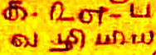
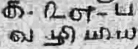
Stage | Process Description | Sample Output
Original Palm Leaf | Acquisition of raw manuscript image captured from ancient Tamil Palm Leaf using a digital imaging device
Grayscale | Conversion of the RGB image to grayscale to reduce computational complexity and focus on intensity information

Slide 9

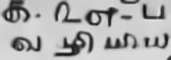
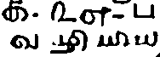
Median Blur Filter | Application of a non-linear median filter to suppress salt-and-pepper noise while preserving edge details
NLMD for denoising | Advanced noise reduction using Non-Local Means Denoising that considers similar patches across the image to preserve texture
Adaptive Thresholding | Local binarization technique where the threshold value is calculated for smaller regions, enhancing contrast and detail in unevenly illuminated areas

Slide 10
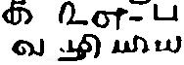

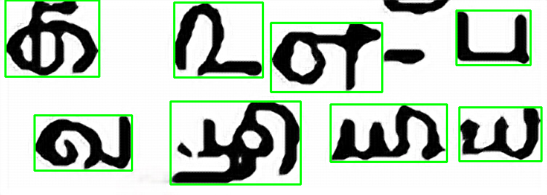
Cleaned | Morphological operations and small component removal to eliminate residual noise and artifacts
FSRCNN for Resolution | Application of Fast Super-Resolution Convolutional Neural Network (4 times) to enhance spatial resolution and restore fine details
Bounding Box | Detection and annotation of individual character regions using bounding boxes on contour detection

Slide 11
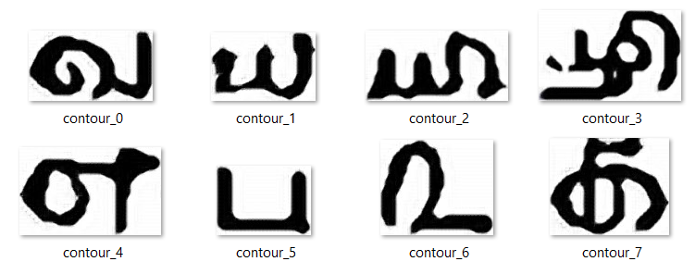
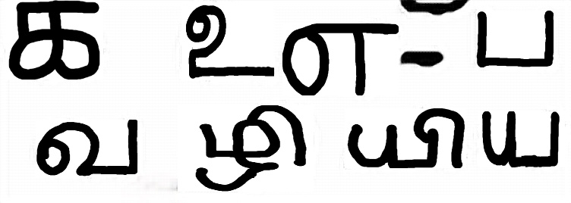
Extracted Characters | Isolation and extraction of segmented characters from the identified ROIs for further recognition tasks
Recognised | Classification of extracted characters using a Convolutional Neural Network (CNN), which automatically learns spatial hierarchies of features from the input images.

Slide 12
Modules
Module 1: Dataset Acquisition / Generation
Module 2: Preprocessing
Module 3: Binarization
- Adaptive thresholding
Module 4: Cleaning the image
Module 5: Enhancement
- Super Resolution: FSRCNN
Module 6: HPP, VPP, Punch Hole Removal
Module 7: Bounding Box
Module 8: Character extraction and recognition
-CNN model

Slide 13
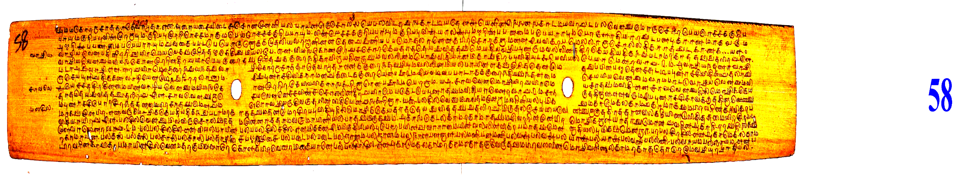
Experiment and Results
Input: Original Image
The process starts with an original manuscript image.
Thos image is noisy, degraded, or unclear due to age, ink fading, and environmental damage.

Slide 14
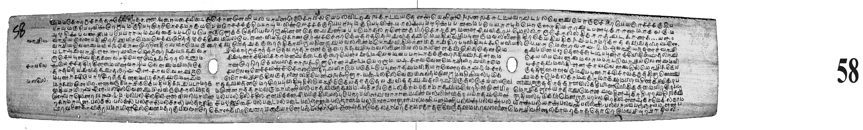
Experiment and Results
2) Grayscale image
Grayscaling is the process of converting a color image (RGB) into a grayscale image where each pixel represents only intensity without any color information.
It is done as it simplifies data, removes unnecessary color information, speeds up computation, for better contrast and feature extraction.

Slide 15

3) Noise reduction
Median blur :
Median Blur is a noise reduction filter used in image processing.
Used for removing salt-and-pepper noise (random white and black dots) while keeping edges sharp.

Slide 16

Non-Local Means Denoising:
Non-Local Means Denoising is an advanced image noise reduction technique that removes noise while preserving textures, patterns, and edges
Non-Local Means Denoising (NLMD) searches the entire image for similar patches and averages them based on similarity, effectively reducing both random and structured noise while preserving important details.

Slide 17
Noise Reduction
Gaussian Filter:
It is a smoothing technique that reduces high-frequency noise.
It applies Gaussian function to blur the image while preserving important structures.
Reduces unwanted noise but slightly blur the edges.

Slide 18
Experiment and Results
CLAHE:
It enhances local contrast in small regions (tiles) of an image.
Improves visibility of fine details often lost in noisy regions.
CLAHE does not remove noise; it only adjusts contrast.

Slide 19
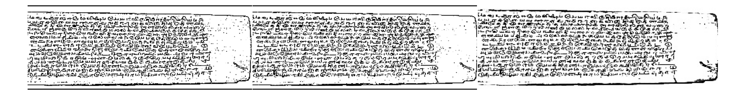
Experiment and Results
Evaluation Metrics:
PSNR- Measures the quality of an image by comparing it to ground truth image.
where MAX is the maximum possible pixel value of the image.
for 8-bit grayscale or color images : MAX=255
for 16-bit images :MAX=65535
MSE - Mean Squared Error between the original image I and the processed image K
Gaussian Filter
PSNR: 26.68 dB
CLAHE
PSNR: 26.89 dB
iii) Median Filter + FNLM
PSNR: 32.71 dB

Slide 20
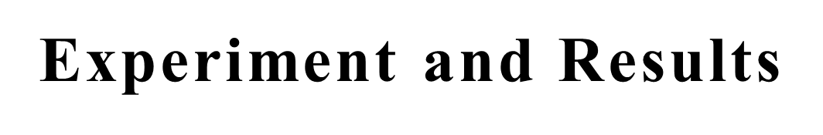
4) Binarization
Adaptive thresholding :
Adaptive Thresholding is used to convert a grayscale image into a binary image (black & white) — especially when lighting is uneven or the image has shadows and varying brightness.
Adaptive thresholding calculates the threshold separately for each small region of the image.
The grayscale image is converted into a binary format, with pixels above the threshold set to white (255) and those below set to black (0).

Slide 21
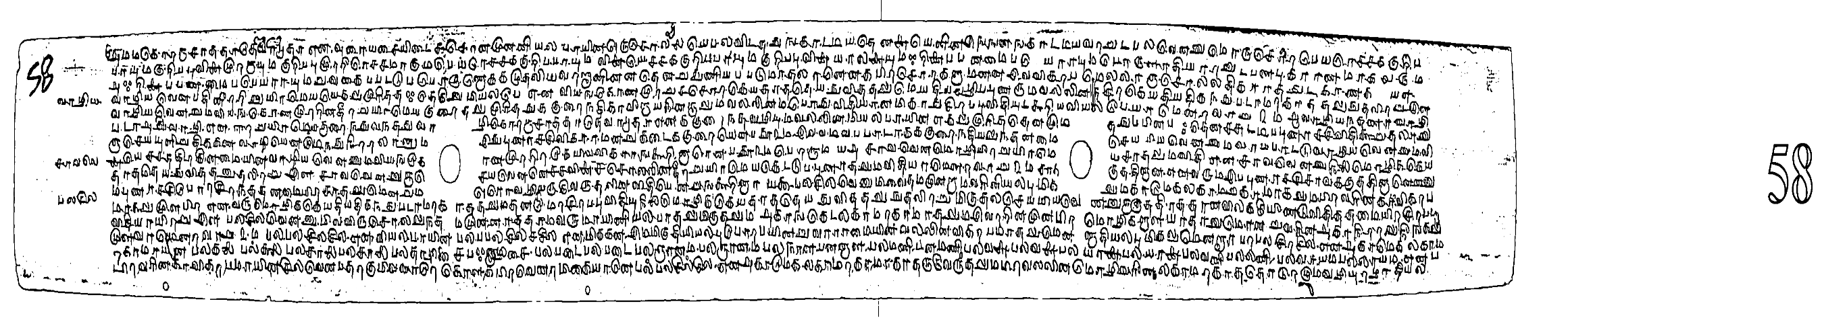
5) Cleaning:
Cleaning ensures the input image is clear and noise-free, allowing deep learning models to focus only on meaningful character patterns rather than distortions
A duplicate of the original image is made to preserve the source, followed by contour detection, format checking, and sorting based on position.
Small, irrelevant contours are removed using area and size filters, and valid regions are cleaned by masking and filling them with white pixels.

Slide 22

6) Image Enhancement
FSRCNN x4(Fast Super-Resolution Convolutional Neural Network)
FSRCNN upscale the image while preserving text sharpness.
It operates directly on low-resolution images without requiring an up sampling step before entering the network.
The x4 means that the output image will be 4 times the resolution of the input image.

Slide 23
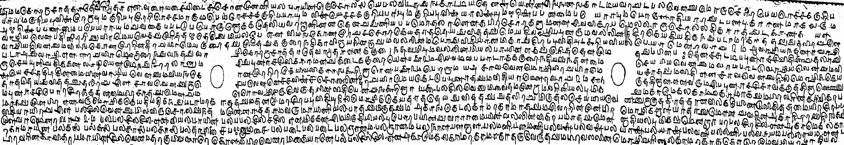
7) HPP and VPP:

Slide 24
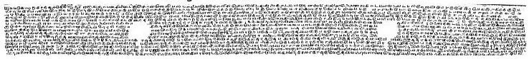
Experiment and Results
Punch Hole Removal:
It is a preprocessing step used to detect and remove these holes while preserving text and other
important features.
Punch hole mask
Image with punch holes removed

Slide 25
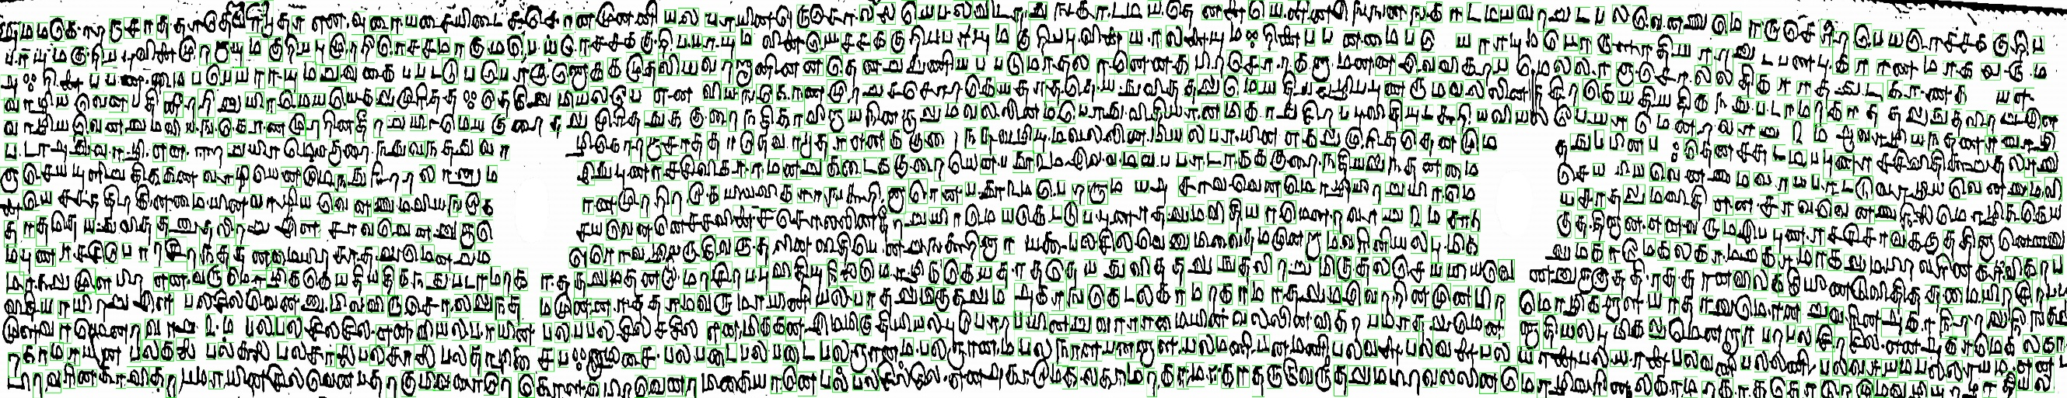
Experiment and Results
Character Extraction:
a) Bounding Box detection
Identifies and marks the regions where text characters are present.
Segments individual letters.

Slide 26
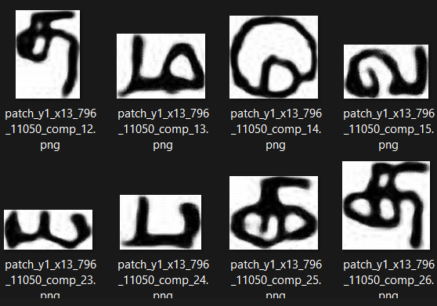
Experiment and Results
b) Extracted Characters
Characters are isolated for recognition.

Slide 27
CNN Architecture
The proposed character recognition system utilizes Convolutional Neural Network (CNN), designed to accurately classify segmented Tamil characters. The architecture balanced depth and computational efficiency while ensuring effective feature extraction from the character images.
Input Layer
The CNN input consists of RGB images of size C × H × W, where grayscale images are expanded to three channels (C=3) for compatibility with the network.
The initial convolution layer applies 16 filters of size 3 × 3 with a padding of 1, preserving spatial dimensions:
Output Size = ( H - K + 2P ) + 1
where : H = input height/width, K = 3 (Kernel size), P = 1 (Padding), S = 1 (Stride)
Thus, the output dimension remains H × W.
Batch normalization is applied post-convolution to normalize the activations and stabilize the learning process. The activation function used is ReLU:
S

Slide 28
Max pooling is then performed with a 2 × 2 kernel and stride 2, effectively downsampling the feature maps. After the pooling step,the output size is reduced to H/2× W/2×16
Second Convolutional Block
The second convolution layer uses 32 filters of size 3 × 3 with padding 1. Similar to the first block, batch normalization and ReLU activation are applied:
Feature Map = ReLU (BN(Conv2D))
This is followed by max pooling, reducing the feature map dimensions further to H/4×W/4 .
Adaptive Pooling Layer
To ensure that the input to the fully connected layer is of fixed spatial dimension, an adaptive average pooling layer is used to reshape the feature maps to a uniform 4 × 4 spatial dimension:
Output Size = (4,4)
This layer automatically adjusts the kernel size and stride to achieve the target output size, regardless of input dimension variations.

Slide 29
Regularization with Dropout
A dropout layer with a rate of 0.15 is incorporated to mitigate overfitting by randomly setting 15% of the activations to zero during training
Fully Connected Layer
The output of the adaptive pooling layer, flattened to a vector of size 32 × 4 × 4 = 512, is passed through a fully connected (linear) layer to produce class scores corresponding to the number of Tamil character classes:
Output = W x + b
Where W R^{68× 512} (weights), b R⁶⁸ (bias), output dimension: 68 classes (as defined in the model)

Slide 30
Layers | No. of input channels | No. of output channels | Kernel Size | Padding
Conv1 | 3 | 16 | 3 x 3 | 1
Conv2 | 16 | 32 | 3 x 3 | 1
Size of pooling window | Stride
2 | 2
Input size of FC layer | Output size of FC layer
32 × 4 × 4 | 69

Slide 31
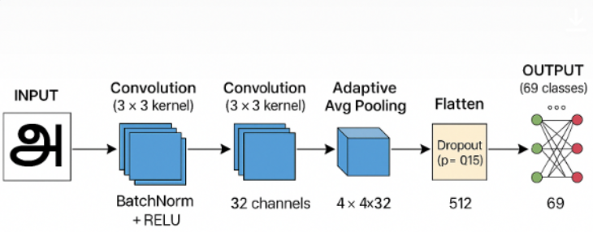

Slide 32
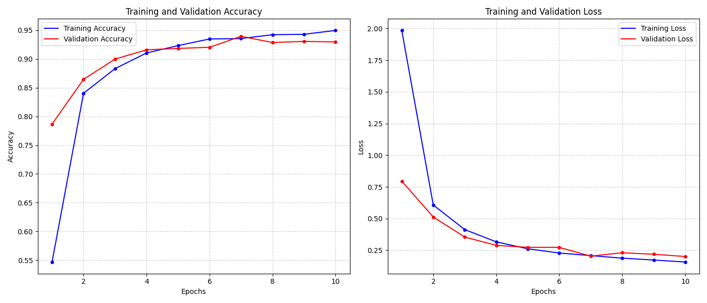
Model Training

Slide 33
Test data Results
Test Loss: 0.1694
Test Accuracy: 94.92%
Weighted-average ROC AUC: 0.9996
Micro-average ROC AUC: 0.9997
Mean Average Precision (mAP): 0.9819
Macro-average Precision: 0.9819
Class label | Precision | Recall | F1-score | support
1 | 0.89 | 1.00 | 0.94 | 32
10 | 1.00 | 1.00 | 1.00 | 19
11 | 0.77 | 0.96 | 0.85 | 24
12 | 0.95 | 0.83 | 0.88 | 23
13 | 1.00 | 0.92 | 0.96 | 26
14 | 1.00 | 0.94 | 0.97 | 31
15 | 0.84 | 0.78 | 0.81 | 27
16 | 0.94 | 0.97 | 0.96 | 34
17 | 0.91 | 0.81 | 0.86 | 26

Slide 34
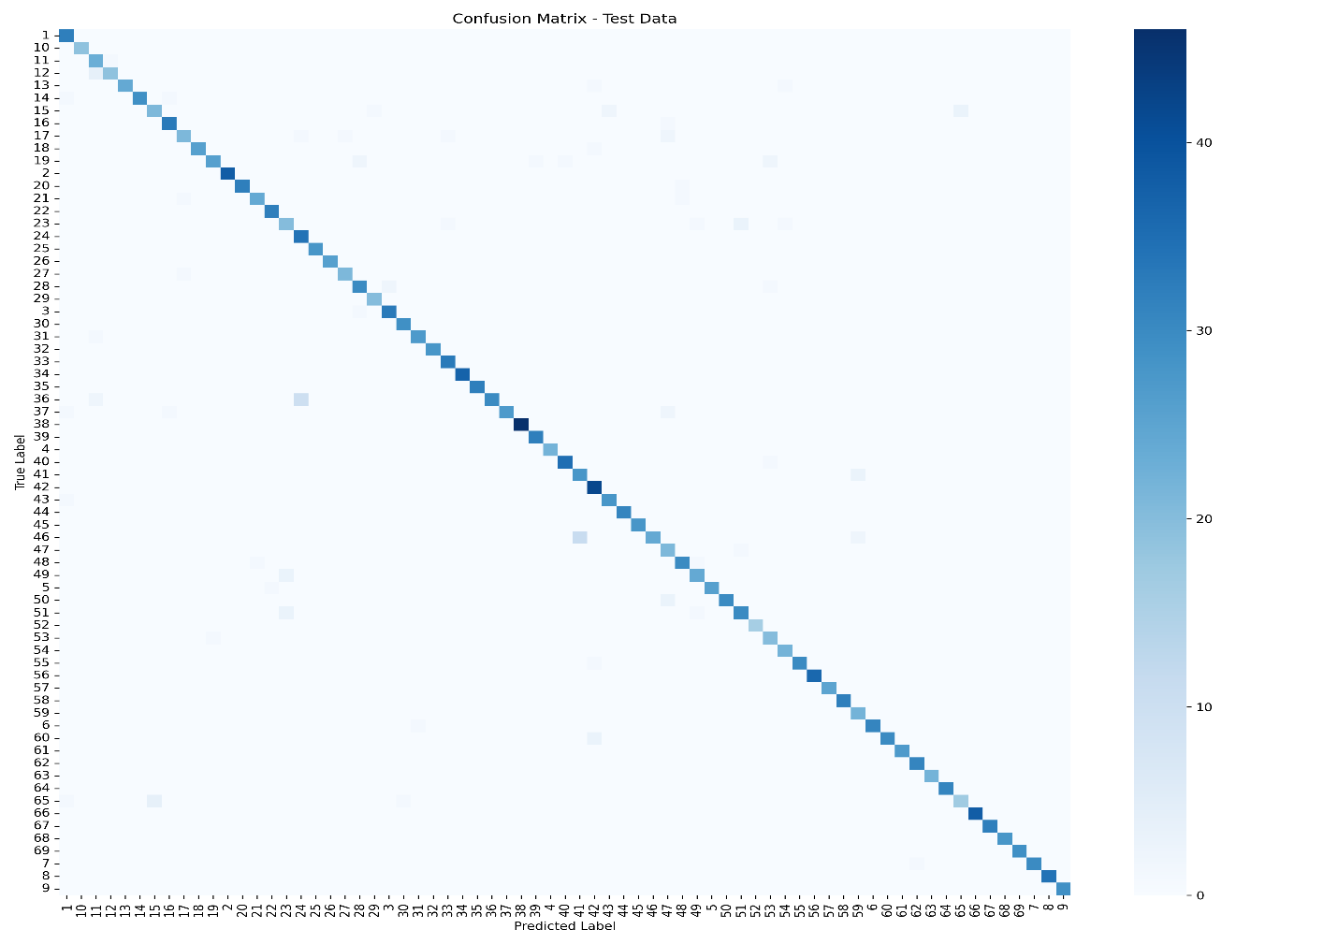
CNN Model Evaluation
Confusion matrix

Slide 35
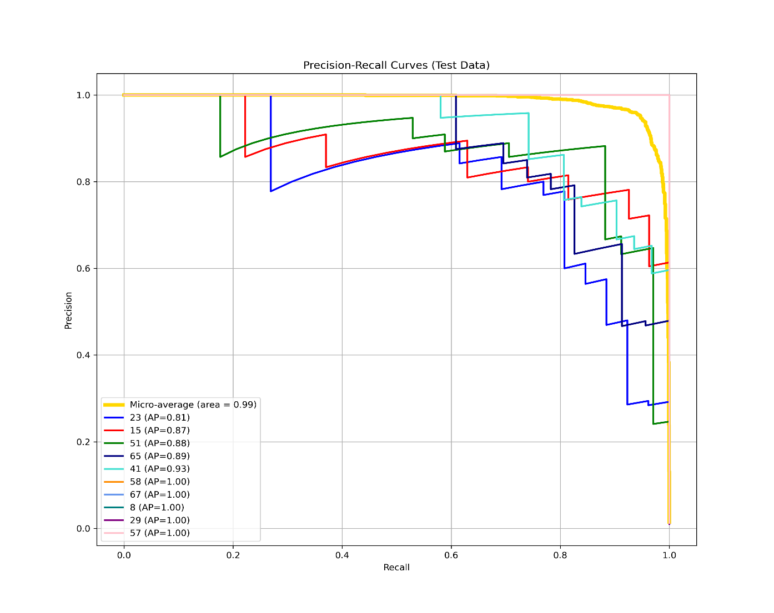
CNN Model Evaluation
Precision recall curve

Slide 36
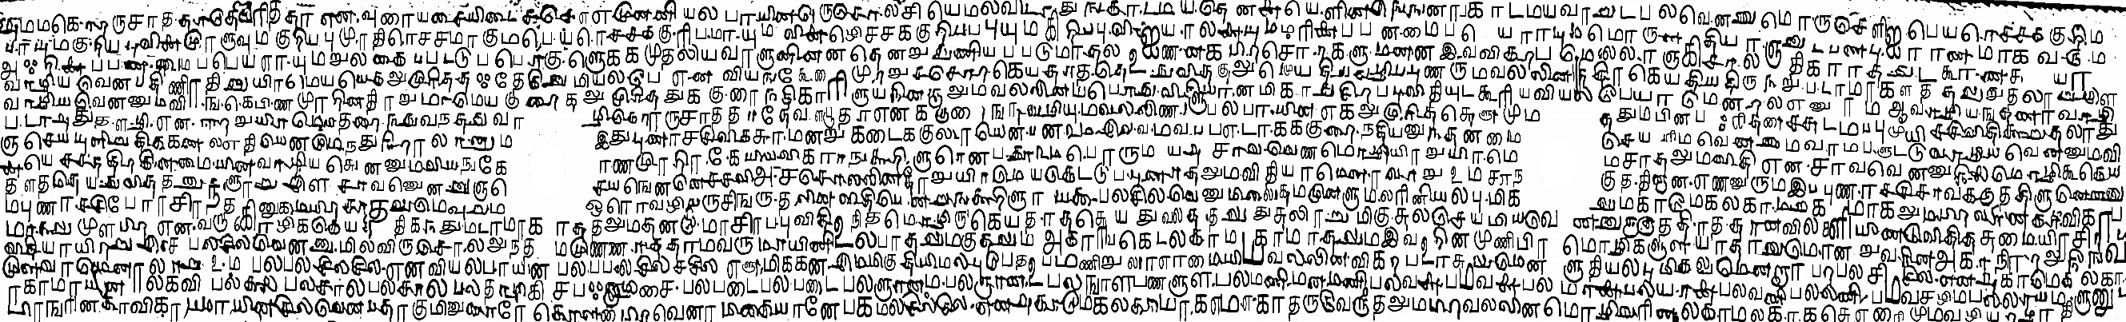
Final Output
The extracted characters are mapped to their corresponding ground truth labels to ensure accurate identification, and the recognized characters are then replaced back into the original palm leaf manuscript, reconstructing the document with correctly identified text.
Palm Leaf Number – 66
Total Images – 904
Correct Predictions – 814
Overall Accuracy – 90.04%
Macro Precision – 0.8329
Macro Recall- 0.8551
Macro F1 Score – 0.8078

